Slide 1
C.LABEL-VR
VR-System for ImmersiveAnnotation of
3D Point Clouds

Slide 2
Schedule
Introduction
Motivation
Project goal
Introduction to Virtual Reality
System Components
The VR-Headset
The VR-Computer
The VR-Development Platform
The C.LABEL-VR Application
Import & Export
Navigation
Annotation
User Interface
Use Case
Conclusion
Challenges
Future Work

Slide 3
1. Introduction

Slide 4
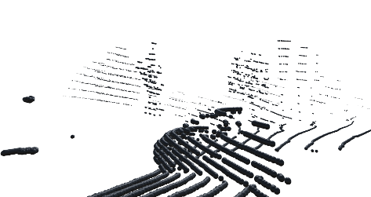
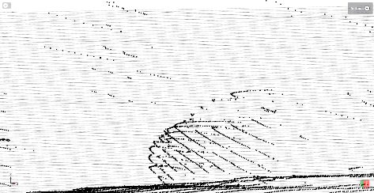
1. Introduction
a. Motivation
Improvement of label process
Intuitive control
User moves himself
Better Visualization
Point clouds in right scale
Touchable sensor data
Stand out from the competition
VR in industry is rare
Eye catching at exhibitions
VR is fun for most people
Very impressive for non technical people

Slide 5
1. Introduction
b. Project goal
Put together a system for developing and running of VR applications
Implement an application with following features:
Import and Export of at least one common point cloud data format
Visualization of the point cloud data
At least one possibility to move through a point cloud
At least one possibility to label points in a point cloud
Extend the application by new:
Labeling techniques
Navigation modes
Data formats

Slide 6
1.Introduction
c. Introduction to Virtual Reality
Beginning
The first ideas for a virtual environment came from I. E. Sutherland in 1965 ^{[1]}:
Display should serve as many senses as possible
Controls with force feedback joystick
Computer should sense human body muscles (hands, arms, eyes)
Manipulate the physics in the virtual world
Concepts which never before had any visual representation can be shown

Slide 7
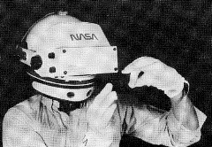
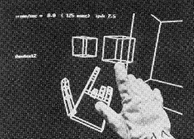
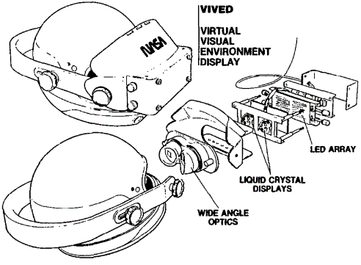
1.Introduction
c. Introduction to Virtual Reality
First Developments
VIVED System developed by the NASA ^{[2]}:
Head mounted device with integrated display (2,7”)
Integrated wide angle optics
Illusion of depth by stereoscopy
Input through voice recognition and gloves with motion sensors

Slide 8
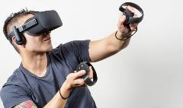
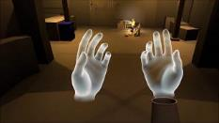
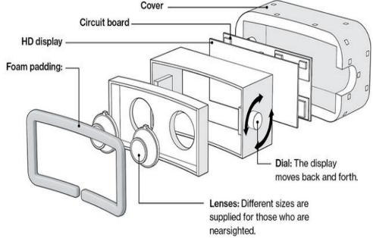
1.Introduction
c. Introduction to Virtual Reality
Today
VR as entertainment system, affordable by anyone:
Concept of VR system hasn’t changed
Better Display (2160 x 1200)
Additional tracking sensors
Faster computation by external PC
[3]
[4]
[5]

Slide 9
2. System Components

Slide 10
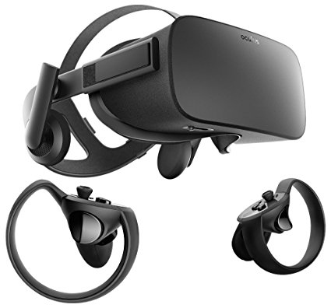
2.System Components
a. The VR-Headset
Oculus Rift
by Oculus VR, LLC.
2013: First developer version
2014: Facebook purchased Oculus for $2 billion
2016 : Official release of Oculus Rift

Slide 11

2.System Components
The VR-Headset
Why VR?
Virtual Reality
Dwad
Awdawd
Adawd
Adwawd
Saekfjnw
Fwf
wefgw
Augmented Reality
Dwad
Awdawd
Adawd
Adwawd
Saekfjnw
Fwf
wefgw

Slide 14
Bibliography
[1] I. E. Sutherland, “The ultimate display,” in Proceedings of the IFIP Congress, 1965, pp. 506–508.
[2] S. S. Fisher, M. McGreevy, J. Humphries, and W. Robinett, “Virtual environment display system,” in Proceedings of the 1986 workshop on Interactive 3D graphics - SI3D '86. ACM Press, 1987.
[3] MSPoweruser, “All oculus rift users left in the dark following “cant reach oculus runtime services” error: Update – patch now available,” Internetquelle (abgerufen am 07.05.2018), May 2018. [Online]. Available: https://mspoweruser.com/all-oculus-rift-users-left-in-the-dark-following-cant-reach-oculus-runtime-services-error/
[4] TheMorenar, “Oculus rift cv1 - vrtk avatar sdk gamedev 3,” Internetquelle (abgerufen am 07.05.2018), May 2018. [Online]. Available: https://www.youtube.com/watch?v=Czc4V-Mxb5k
[5] P. R. Desai, P. N. Desai, K. D. Ajmera, and K. Mehta, “A review paper on oculus rift-virtual reality headset,” CoRR, vol. abs/1408.1173, 2014.

